Slide 1
CPS 109 - Lab 2

Slide 2
Agenda
1 - Recap
2 - Operators
3 - If Statements
4 - Lists
5 - Loops

Slide 3
Recap of Last Week
Remember last week we went over a lot of new stuff! Not remembering all of it is completely fine.
I recommend reading over datatypes again if you’re unsure.

Slide 4
Operators
Operators are, in essence, the backbone of programming. They’re instructions that the computer recognizes and uses to manipulate or check data.
Anything from boolean comparisons, to mathematical operations, to comparisons.

Slide 5
Common Operator Examples
Boolean Comparisons:
and, or, not
Mathematical Operations:
+, -, *, /, //, **, %
Comparators:
Greater than / or equal to | > / >=
Less than / or equal to | < / <=
Equal to / not equal to | == / !=
Notes:
https://docs.python.org/3/library/operator.html#mapping-operators-to-functions (Ignore the functions on the right!) - Useful to paste in the chat for the students

Slide 6
Some Syntax
Let’s talk about this statement:
What is this line, exactly? In short, this tells the computer what code to execute when the main file in a program is run. From now on, put all your code in this block (until we tell you otherwise)

Slide 7
If Statements
Was that weird thing on the previous slide an if statement? Yes!
But what is an if statement?

Slide 8
If Statements
An if statement is a piece of code which asks the computer if something is true.
If the statement is true, then the computer will do something.
You can use elif and else to perform other tasks given whether something is true or false.

Slide 9
If Statements
x = 3 # Declaring the variable x to be equal to 3
if (x == 3):
print(“x is equal to 3”)
if (x <= 2):
print(“x is less than or equal to 2”)
elif (x == 4):
print(“x is equal to 4”)
else:
print(“x is greater than 2 but not equal to 4”)
if (x == 3):
print(“and x is equal to 3!”)
print(“FIN”)
The syntax is as follows:
if/elif/else (condition):
things to do if condition is True
more things to do if condition is True
things that will happen regardless
Notice: indentation, the colon
Example output:
x is equal to 3
x is greater than 2 but not equal to 4
and x is equal to 3!
FIN

Slide 10
Lists
A list is simply a collection of data/variables/objects denoted with a set of [] and separated by commas, like so:

Slide 11
Introduction to Loops
Do you want to repeat a bunch of code until you achieve something specific? Maybe until you reach a certain number of iterations or you find what you’re looking for in a list?
You need a loop for that.

Slide 12
Introduction to Loops
What is a loop?
A loop is a certain set of instructions (syntax) that the computer knows to repeat until a condition is met.
Kinds of loops: while, for, nested

Slide 13
Loops: For
A for loop will repeat a specific set of instructions (written by you) for the amount of time/number of iterations specified.
Simply put: the computer will do something x amount of times.

Slide 14
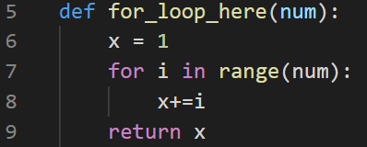
Loops: For

Slide 15
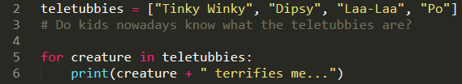
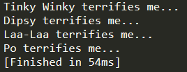
Loops: For Part 2
You can also use for loops to iterate over a list, or the characters in a string.

Slide 16
Loops: While
A while loop will follow a set of instructions while its boolean condition holds true.
Simply put: the computer will do x instructions until y is false.

Slide 17
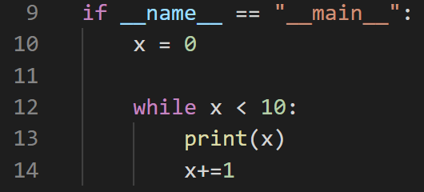
Loops: While

Slide 18
Loops: Nested
Nesting a loop is just a fancy way of saying putting a loop inside of another loop.
You can do this as many times as you like as long as you don’t care about your computer catching fire.

Slide 19
Loops: Nested
You can put a for loop within a for loop, a while loop within a while loop.
You can also get really spicy and put a for loop in a while loop, or a while loop in a for loop.

Slide 20
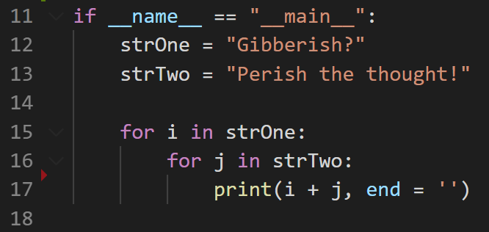
Loops: Nested

Slide 21
Questions?

